Slide 1
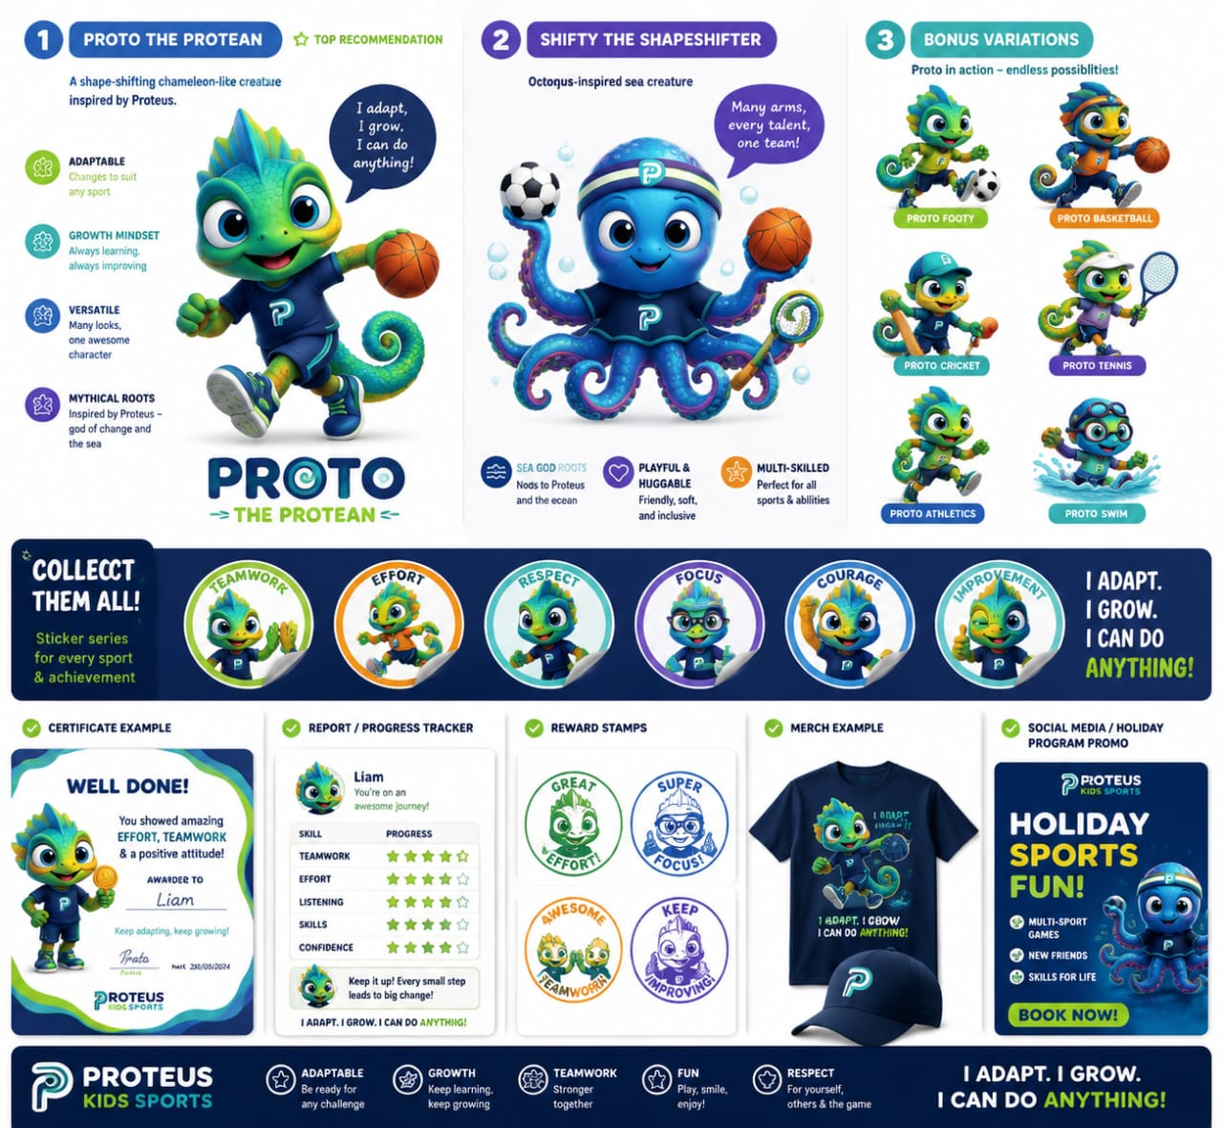
P
PROTEUS KIDS SPORTS
Play. Learn. Grow. Together.
FUN, ACTIVE & REWARDING — AGES 5–12

Slide 2
01 — PROGRAMS
Our Sports Programs
⚽
🏀
🎾
Football
Basketball
Tennis
Master the beautiful game with our experienced coaches
Shoot and dribble your way to success
Serve, volley, and ace like a champion
🏊
🏃
🏏
Swimming
Athletics
Cricket
Dive into a world of aquatic excellence
Run, jump, and throw your personal best
Bat, bowl, and field like a champion

Slide 3
02 — WHAT WE STAND FOR
Core Values
🎉
🌱
Fun First
Growth Mindset
Sport should feel like the best part of a child's week.
We celebrate effort over outcome. Every stumble is a stepping stone.
🤝
🏆
Engagement
Achievement
Sticker rewards, progress trackers, and certificate moments keep kids invested.
We recognise every milestone — big or small.

Slide 4
03 — REWARDS
Achievements & Rewards
🎓
⭐
🏅
📊
Certificates
Digital Badges
Stickers
Track Growth
Official certificates for program completion
Exclusive badges unlocked with progress
Collectible Proto-themed sticker packs
Gamified progress tracker for every child
🥇
🥈
🥉
⭐
Gold Badge
Silver Badge
Bronze Badge
Star Cert

Slide 5
04 — SHOP
Proto-Themed Merchandise
👕
🧢
💧
Proto T-Shirt
Proto Cap
Water Bottle
$14.99
$12.99
$16.99
🎒
🧦
🏅
Backpack
Socks (5-Pack)
Sticker Pack
$34.99
$9.99
$4.99

Slide 6
05 — DIGITAL
Child Progress Dashboard
Football Skills
75%
Teamwork & Cooperation
85%
Fitness Level
90%
⭐ First Goal Scorer
⭐ Team Player Badge
⭐ Perfect Attendance
⭐ Excellence in Training

Slide 7
I Adapt. I Grow. I Can Do Anything.
PLAY · LEARN · GROW · TOGETHER
hello@proteus-kids.com
+1 (555) 123-4567 · 123 Sports Lane, Active City

